Slide 1
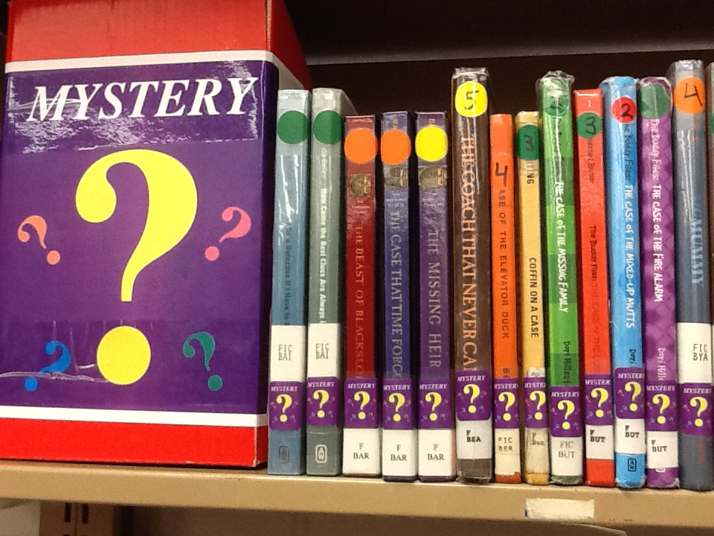
Dewey to Genre-fy
Bells Ferry Media Center
2015
Notes:
This presentation was originally meant to be a flipchart but I don’t think you can open a flipchart without the program so I changed it to a power point presentation. This presentation is for the students. This presentation is for students grades 3-5. After a brief introduction I will read each slide and point out the sections in the library.

Slide 2
What is the definition of a fiction book?
A made up story invented in the mind of the author; a story that did not really happen.
What is the definition of the word genre?
A particular type of book category.

Slide 3
Adventure
A story with a lot of action and excitement, fast-paced, involves danger. There is often an enemy and a journey or quest.

Slide 4
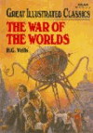
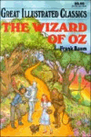
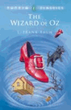
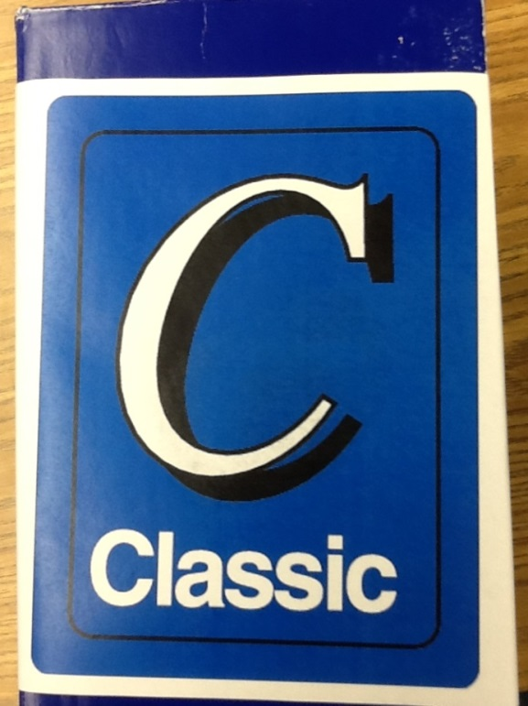
Classic
A book that people have enjoyed for a long time. An expression of life, truth and beauty.

Slide 5
Fantasy
An imaginative story, that deals with supernatural events or characters.

Slide 6
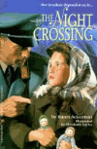
Historical Fiction
A novel set among actual events or a specific period of history. The characters live life as
It really was in the past.

Slide 7
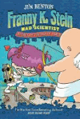
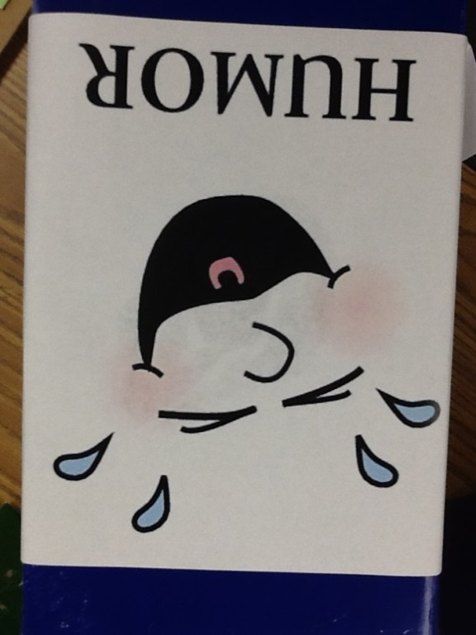
Humor
These books make you laugh and are full of fun.
.

Slide 8
Mystery
The characters are trying to solve a puzzle that often involves a crime. The writer gives clues to the reader.

Slide 9
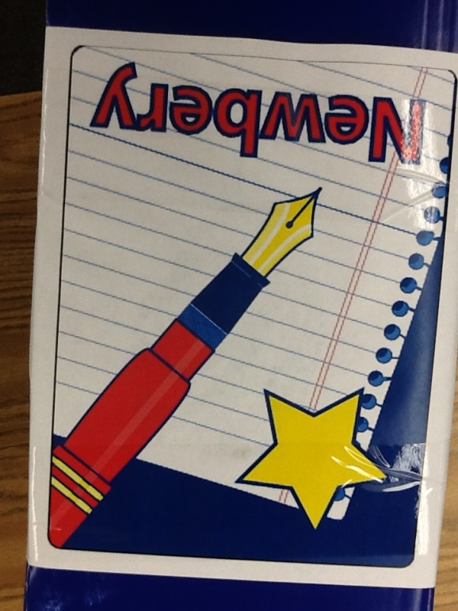
Newbery
These books have been give the honor of being named the best American novels for children for a particular year.

Slide 10
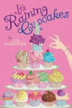
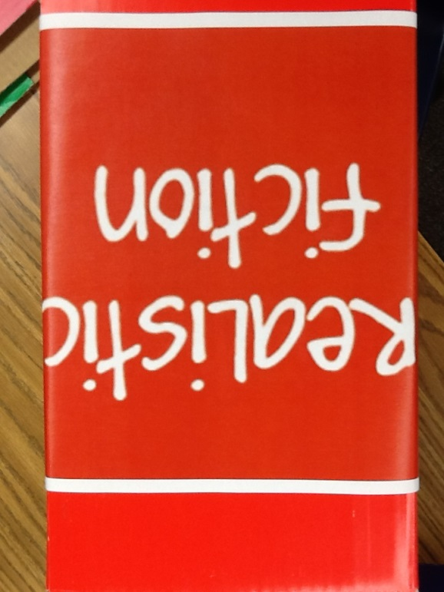
Realistic Fiction
A story with ordinary characters having a real life experiences. Although not true, the events
could possibly happen in real life. The stories can be
serious or humorous.

Slide 11
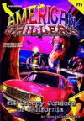
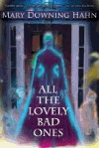
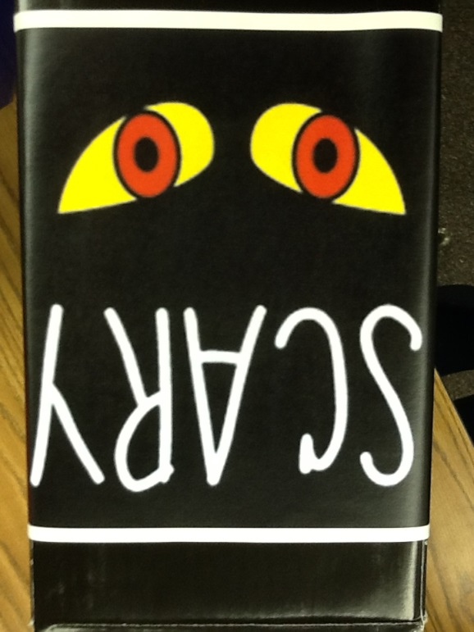
Scary
These books are full of suspense. They can cause a very strong feeling of fear, dread, and shock.

Slide 12
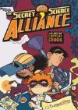
Science Fiction
A story that possibly could happen in the future. It could involve aliens, outer space, robots or time machines.

Slide 13
Sports
Fictional books that have a main character that plays some type of athletic sport.

Slide 14
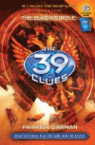
Series
A book series is a sequence of books written by the same author including the same characters on different adventures.

Slide 15
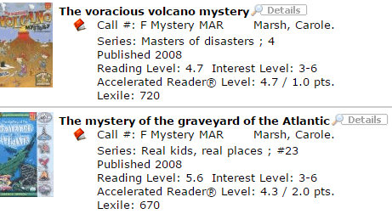
Destiny
Notes:
When you look up a book in Destiny you can find the location of the book by looking at the call number.

Slide 16
Let’s Check Out!

